Slide 1
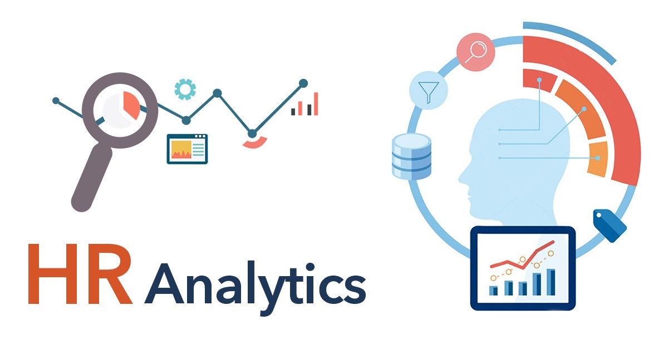
PRESENTED BY
GROUP 1 ☺

Slide 2
KPI 1 : AVERAGE ATTRITION RATE FOR ALL DEPARTMENT
OVERVIEW : The provided data presents the average attrition rates for different departments within your organization. The attrition rates range from 49.44% to 51.21%, with an overall average attrition rate of 50.21%
SUGGESTION : Analyzing the attrition rate for all the department it recommend that employee retention is a significant concern across all departments, as the attrition rates are notably high. Addressing this issue is crucial to ensure a stable and productive workforce.

Slide 3
KPI 2 : AVERAGE HOURLY RATE OF MALE RESEARCH SCIENTIST
OVERVIEW: The provided dataset furnishes insights into the average hourly rates for male employees in various job roles within the organization. The dataset covers a range of roles, from "Developer" to "Sales representative and details the corresponding average hourly rates for cach role. Focusing on the "Research scientist" job role, this analysis aims to comprehend the compensation structure in this specific role and its alignment with organizational benchmarks.
SUGGESTION: Explore potential factors that might contribute to the observed average hourly rate for male employees in the "RS" role. Factors could include job responsibilities, skill requirements, market

Slide 4
Kpi 3 : attrition RATE VS MONTLY INCOME STATS
Overview: The provided data offers insights into employee attrition rates and monthly income statistics across different departments within the organization. The attrition rates range from 49.44% to 51.21%, while the corresponding monthly income statistics vary across departments. This report aims to analyze the relationship between monthly income, attrition rates, and departmental performance, as well as to provide recommend
SUGGESTIONS: Analyzing attrition rates alongside monthly income statistics is a key element of effective employee retention. Use data insights to refine compensation packages, prioritize transparency, and consider performance-based incentives. Invest in career development, gather employee feedback, and tailor retention efforts to specific roles or income levels to foster a loyal and satisfied workforce . dations for addressing attrition challenges.

Slide 5
Kpi 4 : average working years for each department
OVERVIEW : The provided data offers insights into the average total working years across different departments within the organization. The average total working years range from 20 to 21 years, with each department having a similar average value.
SUGGESTIONS : Analyzing the avg working years across various department it recommend to show how the average total working years might impact employee retention and stability within the organization. Longer average working years could indicate a stable workforce, while shorter averages might suggest more turnover and potential challenges.

Slide 6
Kpi 5 :job role vs work life balance
OVERVIEW : The provided data presents the average Work-Life Balance ratings across various job roles within the organization. The average Work-Life Balance ratings range from 2.47 to 2.51, with most job roles clustered around 2.50
SUGGESTIONS : It suggest to present the average Work-Life Balance ratings for each job role and Discuss the significance of work-life balance for employee well-being and organizational success. Explain how a healthy work-life balance contributes

Slide 7
Kpi 6:attrition rate vs year since last promotion rate
OVERVIEW:The provided data presents averages of years since the last promotion and attrition rates for various job roles within the organization. This report aims to analyze the connections between years since the last promotion, attrition rates .
SUGGESTIONS : It suggest that to Discuss the significance of years since the last promotion in terms of career advancement and employee growth. Explain how regular promotions contribute to employee motivation, skill development, Discuss whether employees who have not been promoted in a longer time frame are more likely to leave the organization.

